Slide 1

WSDM - KKBox's Churn Prediction
THOMAS, OLAOLUWA O. SIMEON - MIS-637
10419548
FALL 2017

Slide 2
About KKBox
Asian music streaming service provider founded in 2004 and based in Taiwan.
Major markets are Taiwan, Japan, Hong Kong, Malaysia, Singapore.
30 million tracks with over 10 million users.
Revenue streams - paid subscriptions and advertising
Main source of revenue - Paid subscriptions

Slide 3
Customer Attrition (Churn)
Churn - when customers or subscribers stop doing business with a company or service
More expensive to attract new customers than to keep current subscribers.
Attracting new customers involves working leads through sales funnel while utilizing marketing and sales resources.
Customer retention is more cost-effective as customer trust and loyalty already earned.

Slide 4

How many in the audience have Netflix accounts?
Are you satisfied with their service?

Slide 5
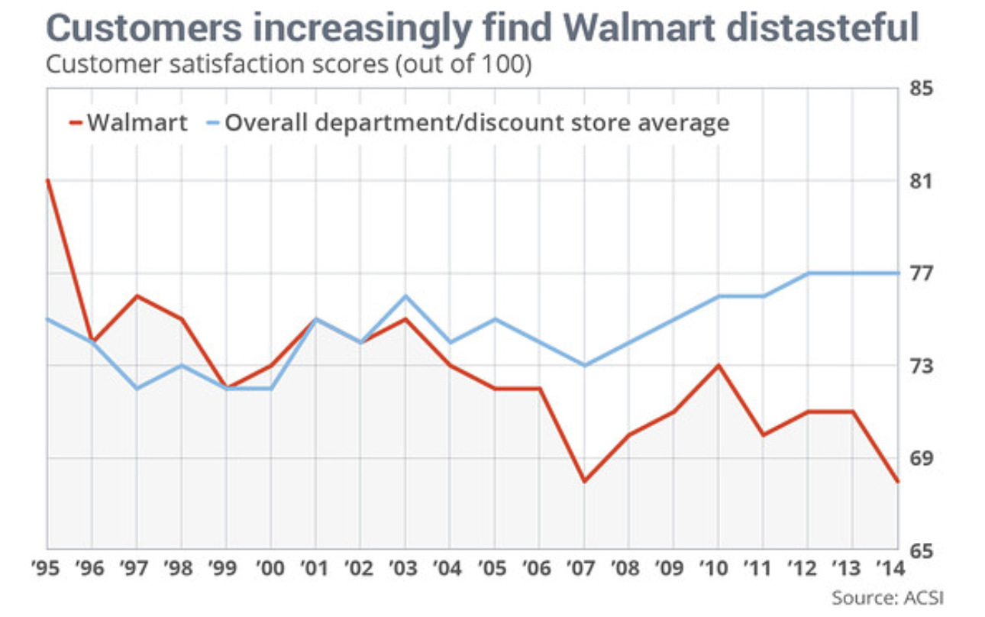
Renowned Companies Hit Hard by Churn
Netflix - In 2011, the sixth-worst customer satisfaction rating among all e-Commerce companies
Walmart - Despite being the largest retailer in the world, since 1994 customer satisfaction level has decreased by 12.5%
Notes:
aration of its streaming and DVD by mail service and sharp price increases, the company had the sixth-worst customer satisfaction rating among all e-commerce companies, and one of the worst among all retailers
EXPE) was the number one online travel company when it came to customer satisfaction. It has since slipped behind Travelocity. The company still is better rated than Orbitz and Priceline. Although overall customer satisfaction with the internet travel industry did not change over the past year, Expedia was the only company in the group where satisfaction decreased.
the company’s customer satisfaction levels, Walmart’s score has decreased 12.5% — the largest drop among all retailers. Walmart has the second-lowest score among all retailers in the department and discount stores sector just beating out Exchange.

Slide 6
Datasets
Members - subscriber information
Transactions - from Jan 1st, 2015 to March 31st, 2017.
User logs - listening behavior in march 2017.
Train - user IDs to build train dataset
Sample submission - user IDs to build test dataset

Slide 7
A Priori Expectations and Concerns
Missing values - we had null values under the gender variable. To solve this, we created a third category we called ‘missing’.
Duplicate entries - duplicates were valid and only showed up because the user logs consisted of daily user behavior in one month.
Imperfect dataset merge - the merge created more null values that were handled according to the pre-existing imputation strategy (median for continuous variables and mode for categorical).

Slide 8
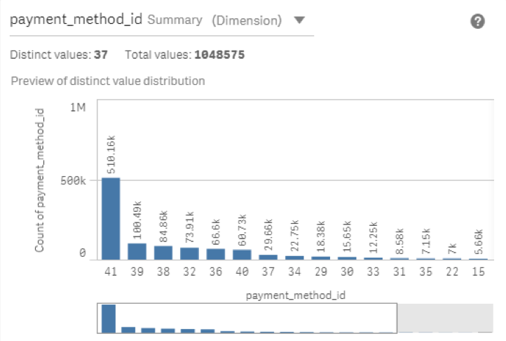
Assumptions
Assumed payment method 41 represents payments by credit/debit card. No way to validate this assumption.

Slide 9
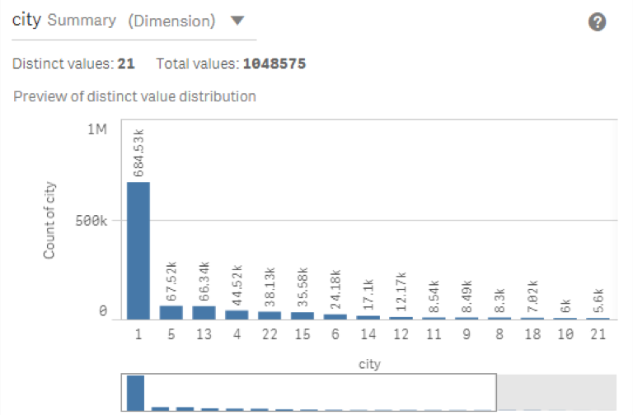
Assumptions and Expectations
2. City 1 assumed to be Taiwan, because it makes up 65% of that variable and Taiwan is the founding country.
3. We expect there to be a difference in churn with respect to gender. Young males are renowned for being more impatient.

Slide 10
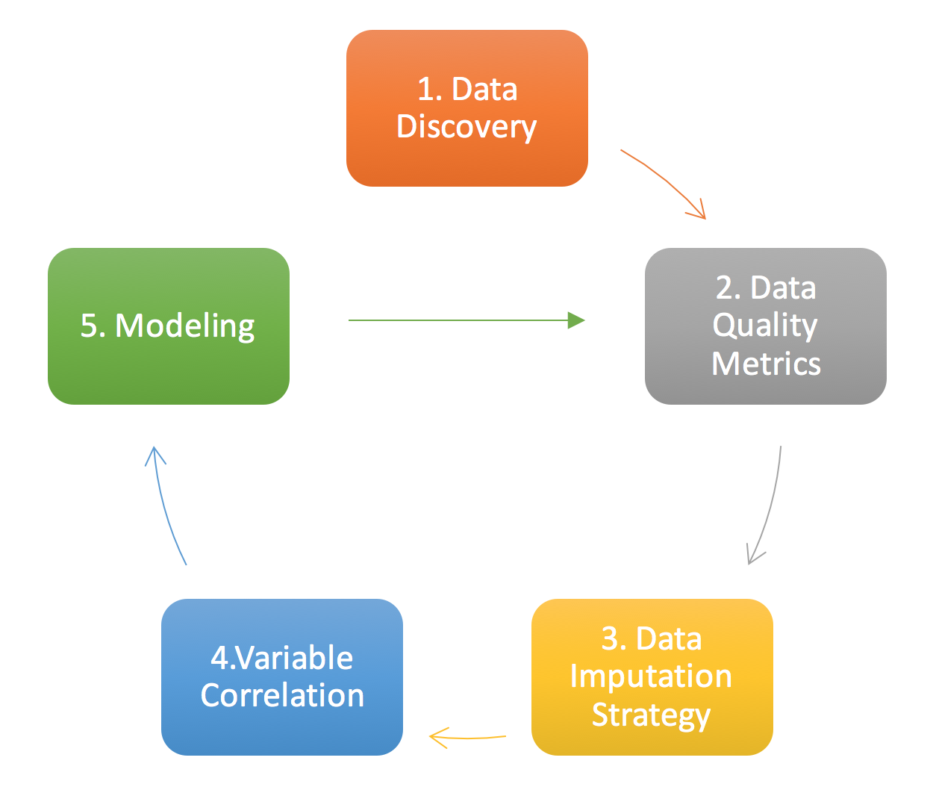
Our Modified Lifecycle
Data Discovery - We ran descriptive analysis on the datasets individually and collectively.
Data Quality Metrics - We measured quality and assessed improvements through an iterative process.
Data Imputation Strategy - We employed three phases of imputation with corresponding changes in our evaluation metric
Variable Correlation and Modeling - We assessed feature importance and adjusted the model appropriately

Slide 11
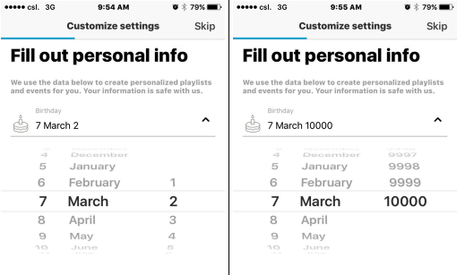
Data Discovery
The sign-up screens for users allows them to input year of birth values from 0 - 10,000.
This data control issue rendered 70% of the age variable highly unreliable and thus set to null.
Data imputation methods were used accordingly, null values were replaced with the median for continuous features and the mode for categorical features.
Screenshots of sign up page

Slide 12
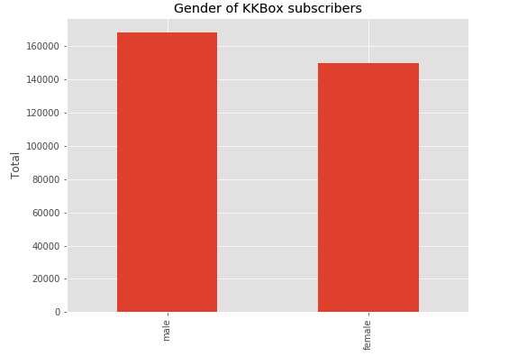
Our Findings on Gender and Churn
We discovered 3.193% of males and 3.199% of females churned contradicting our expectation!
Most highly correlated variables with churn were total amount paid, listening & cancellation history, payment method and plan price.

Slide 13
Data Quality
In the merged dataset,
99.11% of observations in gender belong to the missing category.
9.88% of KKBox’s subscribers churned within data collection window.
Only 6.38% of churners could be identified by a valid gender.
37% of observations had at least one null value.
Therefore, our dataset is 63% complete prior to the first round of data imputation.

Slide 14
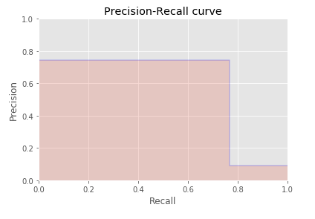
Model Evaluation Metrics
Scikit-Learn’s CART classifier algorithm was applied to 10% of the data (approx. 100,000 observations stratified and extracted to represent an equal distribution of the target classes), the model yielded a 96% accuracy score on both the test and the remaining 90% hold-out set.
Both data sets yielded an F1 score of approx. 0.76 with 4.3% of the target misclassified.

Slide 15
Conclusion
According to CART classifier, top 5 feature that provided the most information:
Subscription plan
Cancellation transactions
Number of transactions
Number of cancellations
Registration Channel
Subscribers on a 7-day payment plan were the heaviest churners as expected.
Notes:
Other significant features not in the top five were total listening time, average number of songs per day, payment method and total amount paid for the duration that data was available.

Slide 16
Recommendations
Extend trial period of 7 days to allow the users more time to avail services.
Work on data entry control to ensure demographic information is captured for a more accurate predictive model.

